Slide 1

Final Presentation
Group 5 Section A
Haobin Liu, Sarmishtha Jain, BoXin Liu, Naing Myo Htet, Apurva Patel

Slide 2
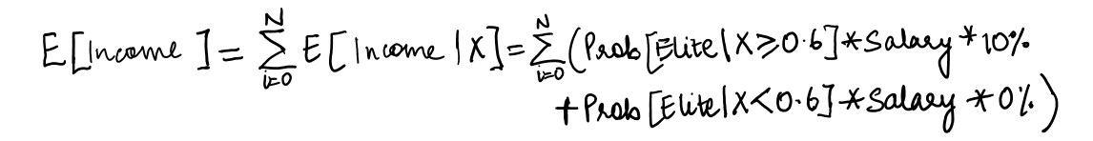
Business Understanding
In the business of talent acquisition
Recruiting company aimed at providing the best HR solutions for data science roles
Analyze the preexisting salary data to classify each individual as elite or non-elite.
Elite == salary > average salary in particular region
Targeting elite candidates
Ran a logistic regression to model the probability of a candidate being elite
Target the candidates with higher probabilities of being elite because it maximizes our revenue.

Slide 3
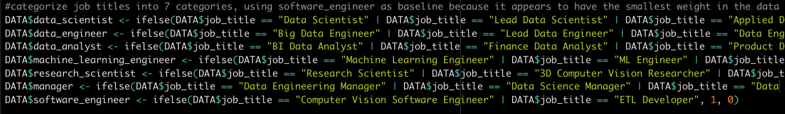
Data Understanding/Prep
Original Data
12 columns (1 identifier column)
607 total observations
Different features included in the dataset
Job title, experience level, remote ratio…
Job title was a categorical feature that had many unique attributes specific to the company (ex: Data Analytics Engineer, Data Architect)
Similar roles based on job description were grouped into 7 primary functions
Assumptions made
Our model is based upon the US dollar for coherence and any exchange rate fluctuations are ignored
Our model also ignores the effects of inflation or any other economic phenomena for simplicity

Slide 4
Modeling
Regression Model: predict the salary for each job candidate
Linear regression
Linear regression with interactions
lasso.min, lasso.1se, ridge.min, ridge.1se
Classification Model: probability estimation on the chance of each candidate having predicted salary above the average in the region
Logistic regression
p(Elite|x) = p(salary|x) > average salary in particular region
Elite = p(Elite|x) > threshold

Slide 5
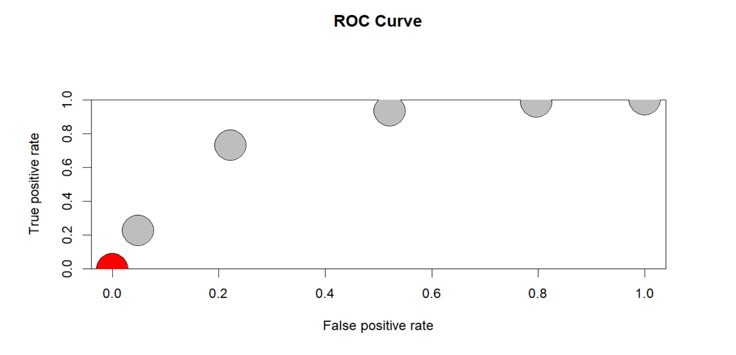
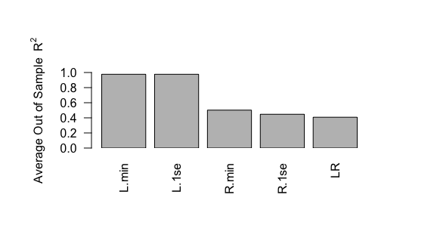
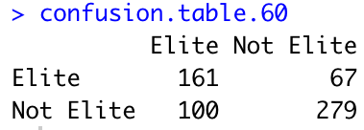
Evaluation/Deployment
Lasso Min has the largest average out of sample R^2 across 10-folds cross validation
Average Out of Sample R^2 = 0.9778239
Through this we set the threshold as 0.6 which gave the maximum accuracy of 72.5%
Through this result we gathered, that out of 607 candidates, around 161+67 were selected for the position, which is around 37.6%

